Slide 1


Slide 2
Excess Deaths over the Coronavirus Period
Definitions:
The 5yr average covers 2015 to 2019 and provides a comparison of the number of deaths expected, per week, in a usual (non-pandemic) year.

Slide 3
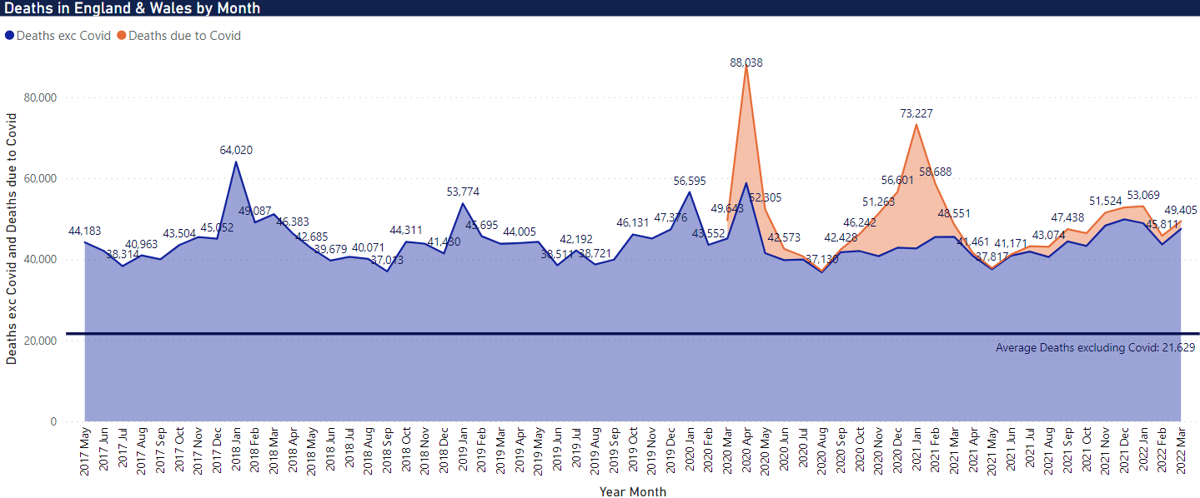
Deaths by Month
Overall picture of deaths (All Causes) and those ‘due to’ Covid in the Spring of 2020.
Notes:
Previous ‘stable’ years show a consistent no. of deaths.
Repetitive peaks in those years are winter highs of seasonal circulating influenza strains
First wave of Covid hits in early Spring, short/sharp due to warming weather.
Contains a second small pear within it, which is unusual in itself.
Second wave in the expected winter season, however, no peak due to other seasonal illnesses like influenza
2022 winter season contains no peak in either ‘normal’ seasonal influenzas, nor Covid. Whether retrospective counts become available in the next months or two.

Slide 4
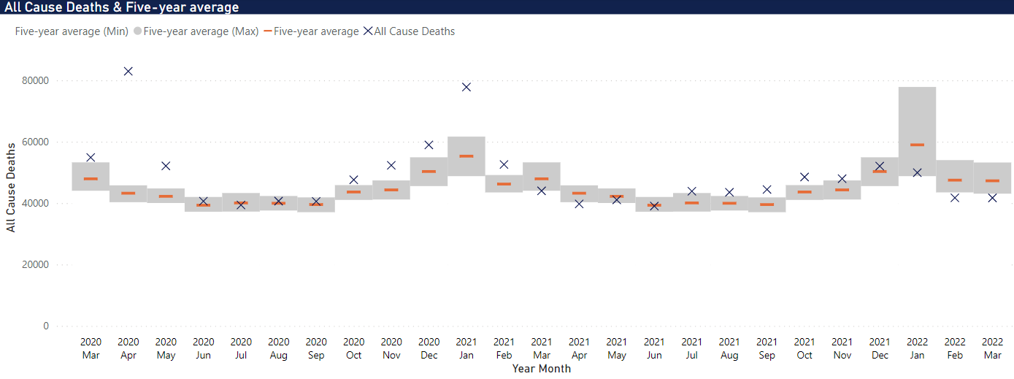
All Cause Deaths by 5yr Average
All Cause deaths over the Covid period compared to the 5-year average (2015-2019)

Slide 5
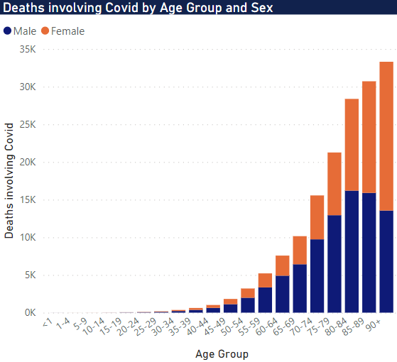
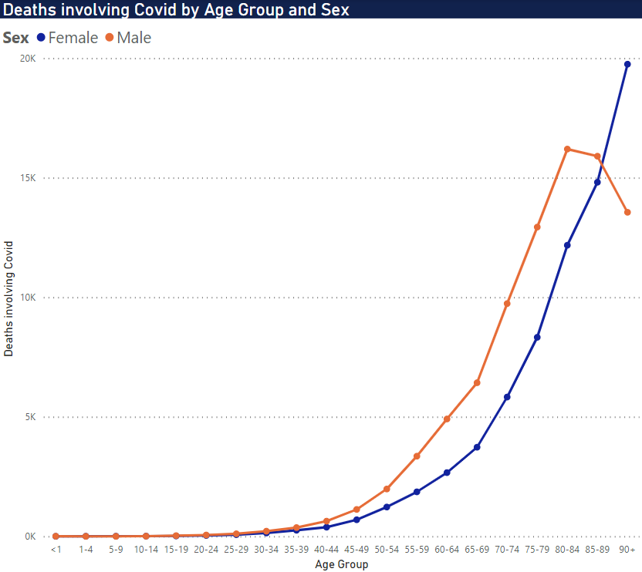
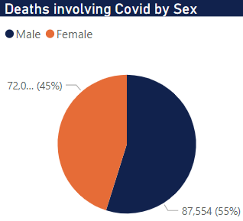
Deaths involving Covid by Sex and Age Group
Sankey chart shows the sex and age-group relationships for deaths in 2021.
Notes:
Left Chart:
Male deaths peak at 80-84 and then fall as age increases.
This may be due to the Male population of such a high age is very small (men have a notable lower life expectancy than females).
Need further investigation into the demographics of that age group, compared to females of the same group

Slide 6
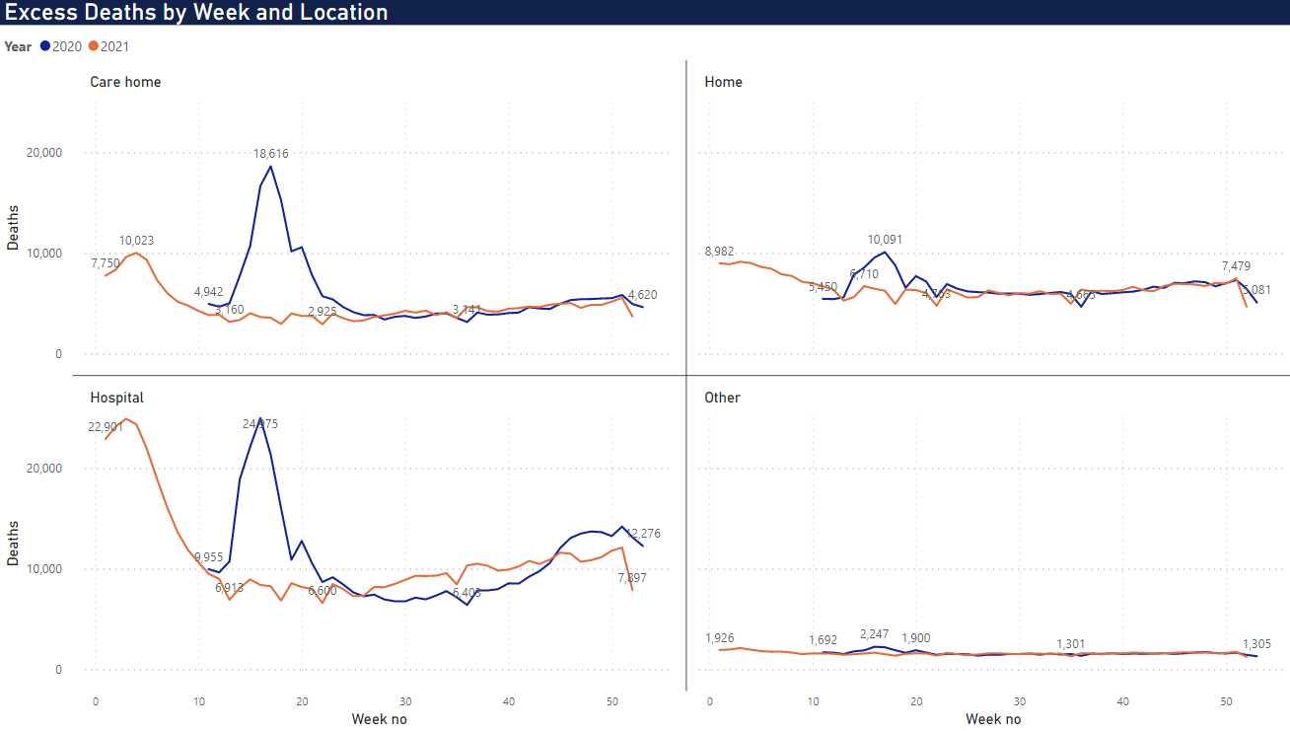
Excess Deaths by Location
* “Home” deaths are those at the usual residence of the deceased (according to the informant)‚ where this is not a communal establishment.
* "Other" includes deaths in communal establishments other than hospitals and care homes, i.e. in hospices, and that occurred "elsewhere".
However, it was an extreme increase
Home deaths had a minimal increase in comparison, albeit still notable
The small troughs are bank holidays, which cause a latency in recording deaths
2020 April (weeks 11+): the first wave to spread through society
Care Homes and Hospitals are the main location of deaths occurring
Given the novel virus hitting in Spring, it was swift and short-lived

Slide 7
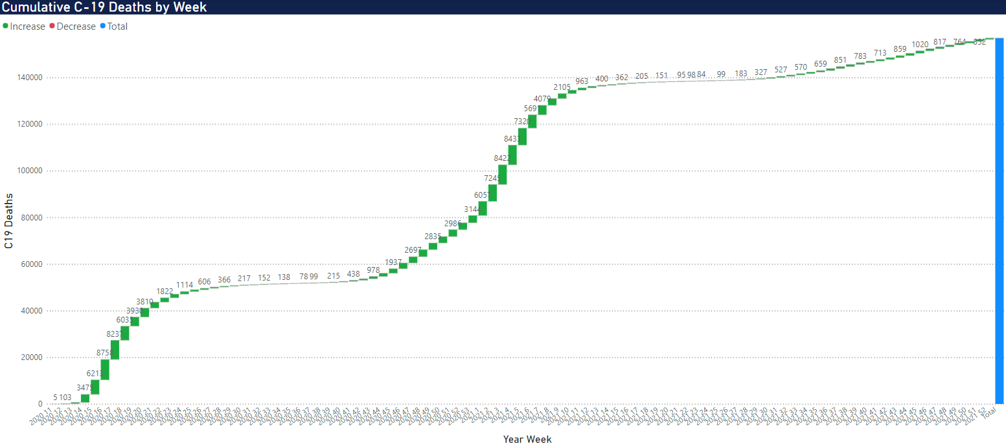
Covid Death Accumulation over 2yrs
Waterfall charts shows the accumulation of Covid deaths over the past 2 years, by week. Again, we can clearly see the seasonality aspect. Being a respiratory disease, warmer weather reduces the prevalence of the virus, until colder weather returns

Slide 8
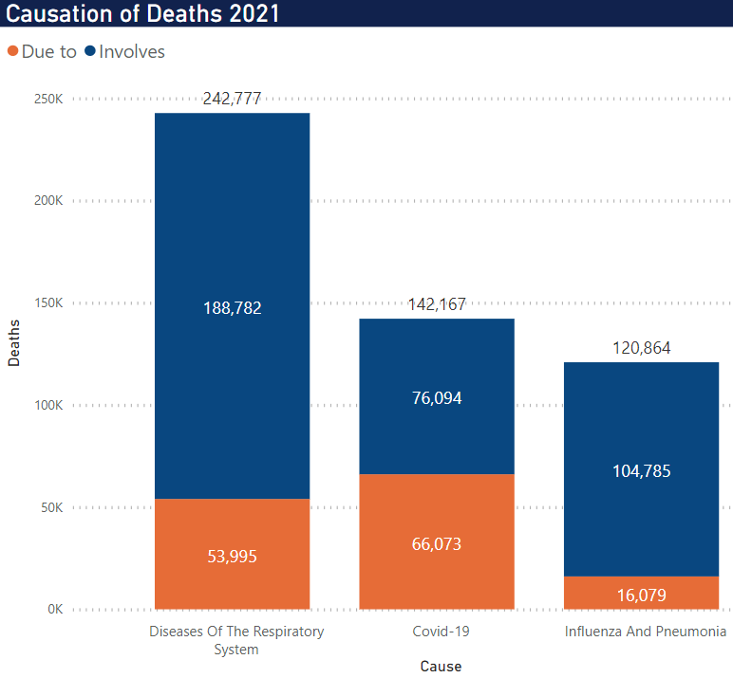
Covid Death Accumulation over 2yrs
This chart shows the causation categories for deaths in 2021.
Deaths ‘Due to’ are a subset of ‘Involving’, and only include deaths where the cause was the underlying (main) cause of death.
Deaths may be counted in more than one cause category, for example a death may have an underlying (Due to) cause of COVID-19 but also have influenza and pneumonia mentioned as a contributory cause of death (Involving).

Slide 9
Summary
The usual winter highs were not present in the second (but full) wave.
Where was the influenza impact we see each season?
Previous four winter seasons were classed as mild.
A higher than usual build-up of elderly/vulnerable persons that were impacted when the virus circulated the population the first time.
Male deaths decrease above the age of 80.
Vaccine uptake figures overlaid against the daily/weekly/monthly deaths figures.
Dedicated influenza A/B deaths figures over the same period.

Slide 10
References
https://www.linkedin.com/pulse/how-make-band-charts-power-bi-carlos-barboza/
Appendix
Data and supporting files found here:
https://github.com/gregorious240/DataVisAssessment.git

